Slide 1


Minor Project 1
Academic Monitoring & Specialization Selection System
Presented by:
Dhuruv Kumar 500107769
Khushi Chauhan 500102244
Shruti Srivastava 500105401
Notes:
Guided by:
Mr. Deepak Sharma
Asst. Professor (SG)
System Cluster
SoCS

Slide 2
Content
Abstract
Introduction
Literature Review
Problem Statement
Objectives
Methodology
Algorithms
Key Components
Working of Algorithms
Data Collection
Sample Dataset
Storage Solution
Design Diagram
SWOT Analysis
Area of Application
Future Enhancements
Conclusion
References

Slide 3
Abstract
This project introduces an innovative dual-purpose academic support system designed to enhance both student guidance and educational management. The system employs advanced algorithms to address two critical aspects of academic progression: specialization selection for students and performance-based grouping for educators.
The first component utilizes a classification algorithm that analyzes students' academic history and personal preferences to suggest optimal specialization paths. This personalized approach aims to align students' interests with their academic strengths, potentially increasing their chances of success in chosen fields.
The second component implements a clustering algorithm to automatically group students based on their academic performance. This feature enables educators to efficiently identify and address varying levels of student achievement, facilitating targeted support for struggling learners and advanced opportunities for high performers.

Slide 4
Introduction
Students struggle with academic choices & educators face challenges in personalized support.
Smart system for higher education guidance and monitoring.
Student specialization guidance and educator performance tracking.
Align student aspirations with academic realities.
Combine personalized student guidance with data-driven insights for educators.
Revolutionize academic planning and performance management.
Notes:
In today's complex educational landscape, students often struggle to choose appropriate academic paths, while educators face challenges in providing personalized support to diverse learner groups. This project introduces an innovative smart system designed to address these critical issues in higher education.
The proposed system serves a dual purpose: guiding students towards suitable specializations and assisting educators in monitoring and supporting student performance.
This integrated approach aims to bridge the gap between student aspirations and academic realities, while also enhancing the efficiency of educational management.
By combining personalized guidance for students with data-driven insights for educators, this project seeks to revolutionize academic planning and performance management. The ultimate goal is to create a more responsive, efficient, and student-centered educational environment that maximizes learning outcomes and student success.

Slide 5
Literature Review
The paper "Performance Analysis of Engineering Students for Recruitment Using Classification Data Mining Techniques"[1] explores using classification methods like Decision Trees and Naive Bayes to analyze students’ performance for recruitment. It shows how data mining can help recruiters identify top candidates based on academic and skill data, making the hiring process more effective.
Quy et al.'s paper, “A Review of Clustering Models in Educational Data Science Toward Fairness-Aware Learning,”[2] reviews clustering algorithms in educational data science, emphasizing the need for fairness and reducing bias. The study highlights the importance of equitable educational outcomes and discusses best practices for implementing fair clustering models.
The paper “How are the Students Selecting their Bachelor Specialization? A Qualitative Approach”[3] explores the factors influencing students’ specialization choices. It highlights the role of personal interests, career prospects, and advice from family and peers in shaping these decisions.
The research paper titled “Classification Algorithms to Determine Students’ Specialization in a Higher Education Institution”[4] aims to assist students in choosing their specialization within the IT field. The study utilizes a dataset of 3599 records with 42 attributes and applies various classification algorithms.
Notes:
Singh and Kumar’s study, “Performance Analysis of Engineering Students for Recruitment Using Classification Data Mining Techniques,” [2] uses data mining to predict engineering students’ recruitment potential based on their academic records. The study categorizes students into performance groups to aid recruitment decisions.
The research paper titled "Clustering Analysis for Classifying Student Academic Performance in Higher Education“[5] proposes a clustering-based approach to classify B40 students based on their performance in higher education institutions (HEIs). The study develops three unsupervised models (k-means, BIRCH, and DBSCAN) using data from B40 students
5. Mohamed Nafuri, Ahmad Fikri, Nor Samsiah Sani, Nur Fatin Aqilah Zainudin, Abdul Hadi Abd Rahman, and Mohd Aliff. "Clustering analysis for classifying student academic performance in higher education." Applied Sciences 12, no. 19 (2022): 9467.

Slide 6
Problem Statement
Higher education institutions face two interconnected challenges that significantly impact student success and educational efficiency:
Students often struggle to select appropriate academic specializations that align with their abilities and interests, leading to suboptimal career choices and potential academic underperformance.
Educators lack efficient tools to identify and address varying levels of student achievement across large and diverse student populations, hindering their ability to provide timely and targeted academic support.
These challenges lead to misaligned academic paths, inefficient resource use, and missed opportunities for personalized learning.

Slide 7
Objectives
To design and implement dual-purpose academic support system to enhance both student guidance and educational management.
Sub Objectives:
Design and implement a classification algorithm that analyzes students' academic history and preferences to provide personalized specialization recommendations.
Create a clustering algorithm to automatically group students based on their academic performance, enabling targeted support and resource allocation.

Slide 8
Methodology
Data Collection for Classification: Gather comprehensive academic records and student preferences to build a robust dataset.
MongoDB for data storage: Implement MongoDB as a scalable, flexible database solution for storing and managing student data.
Implement classification Algorithm for specialization recommendation: Develop a model to analyze student data and suggest suitable academic specializations.
Implement clustering Algorithm for performance-based grouping of students: Create an algorithm to automatically categorize students based on their academic performance metrics.
Design menu driven user interface: Develop an interface that combines specialization recommendations and student grouping functionalities.
Testing and Refinement: Conduct thorough testing of the system and iteratively refine algorithms and interface based on feedback and performance metrics.

Slide 9
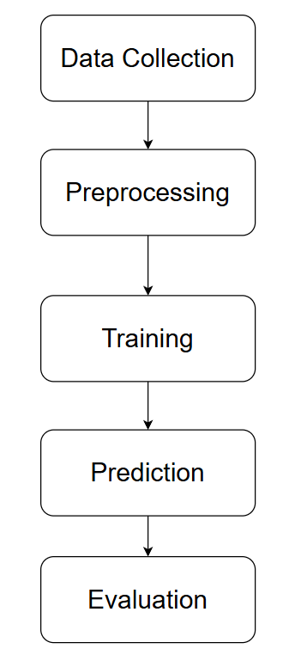
Algorithms
Classification Algorithm for Specialization Recommendations: Decision Tree Classification
Step 1. Data Collection:
Gather data on students' academic history, personal preferences, and specialization requirements.
Step 2. Preprocessing:
Clean the data to handle missing values and normalize numerical features.
Step 3. Training:
Use a decision tree algorithm to create a model that predicts the best specialization based on students' academic history and preferences.
Step 4. Prediction:
By using the student’s input, the model traverses the decision tree to classify the student into the most suitable specialization.
Step 5. Evaluation:
Analyze the model’s accuracy on various kind of students’ data.
Notes:
Classification Algorithm for Specialization Recommendations: Decision Tree Classification
Data Collection: Gather data on students' academic history, personal preferences, and specialization requirements.
Preprocessing: Clean the data to handle missing values and normalize numerical features. Encode categorical variables (e.g., specializations) into numerical format.
Training: Use a decision tree algorithm to create a model that predicts the best specialization based on students' academic history and preferences. The decision tree splits data based on feature values to create a tree structure that classifies students into different specializations.
Prediction: Input a new student's academic history and preferences into the trained model. The model traverses the decision tree to classify the student into the most suitable specialization based on learned patterns.
Evaluation: Assess the model's accuracy using metrics such as precision, recall, and F1-score.Adjust the model parameters if necessary to improve performance.

Slide 10
Key Components
Decision Tree Classification for Student Specialization Recommendation
Decision Tree Class: - DecisionTree(): Initializes the decision tree - calculateEntropy(): Computes the entropy of the dataset - calculateInformationGain(): Calculates the information gain for a specific attribute - buildTree(): Recursively builds the decision tree using students and attributes
Node Class: - MethodsNode(): Creates a new node with a specified attribute and value - isLeaf(): Checks if the node is a leaf (no children).

Slide 11
Working Of Algorithms
Decision Tree Classification for Student Specialization Recommendation
Select best attribute for splitting (highest information gain) - Entropy: Measure of impurity in a group of examples - Information Gain: Reduction in entropy after a dataset is split on an attribute - Goal: Choose attributes that result in the highest information gain at each split
Create a node for the selected attribute - Calculate information gain for each available attribute - Select the attribute with the highest information gain - This attribute becomes the decision node for the current level
Split the data based on attribute values & Recursively build subtrees for each split - Start with the entire dataset at the root - Select the best attribute to split on - Create child nodes for each value of the chosen attribute - Recursively apply the process to each child node - Stop when all examples have the same specialization or no attributes remain - Create leaf nodes when a stopping condition is met
Recommend specialization to the student - Start at the root node of the constructed tree - Evaluate the student's value for the attribute at each node - Move to the appropriate child node based on the attribute value - Repeat until a leaf node is reached- The specialization at the leaf node is the recommendation

Slide 12
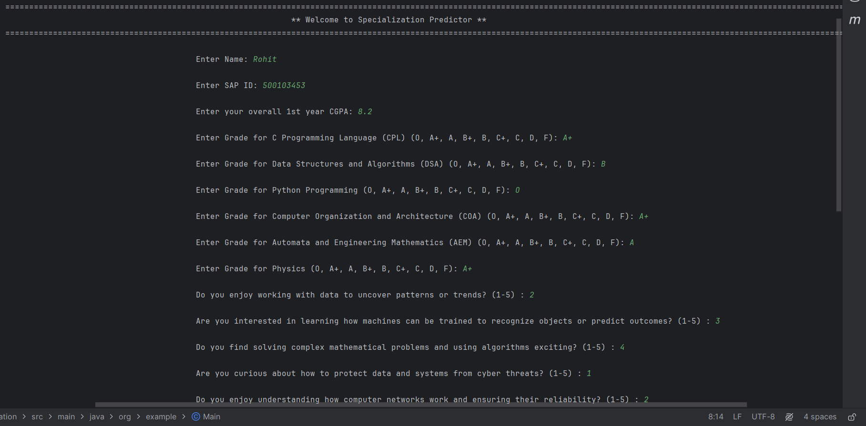
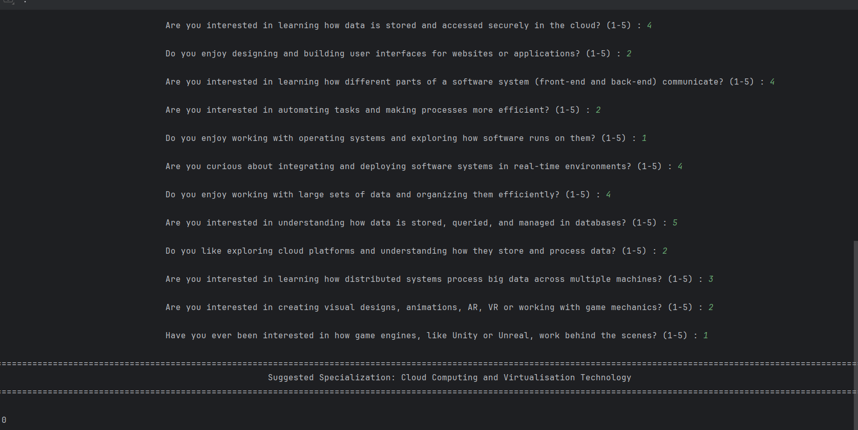
Outputs

Slide 13
Data Collection For Classification
Data Collection Process: We collected initial data using a Google form with around 50 entries. However, this dataset was insufficient for training the Decision Tree algorithm effectively.
Synthetic Data Generation: To overcome the limitation of insufficient data, we generated synthetic data, enabling a larger and more diverse dataset to train the decision tree model for specialization recommendations.
Sample Dataset Structure: The dataset includes comprehensive academic and technical skill-related information along with students' final specialization choices.
Features Included: Academic Scores: CGPA of the 1st year, grades in core subjects like DSA, Python, COA, etc. Technical Interests: Self-assessed interest levels in fields like Data Patterns, Machine Learning, Cybersecurity, Networking, Cloud Storage, and others. Specialization Chosen: The final field lists the specialization chosen by each student (e.g., BIG DATA, AI/ML, Cloud Computing).

Slide 14
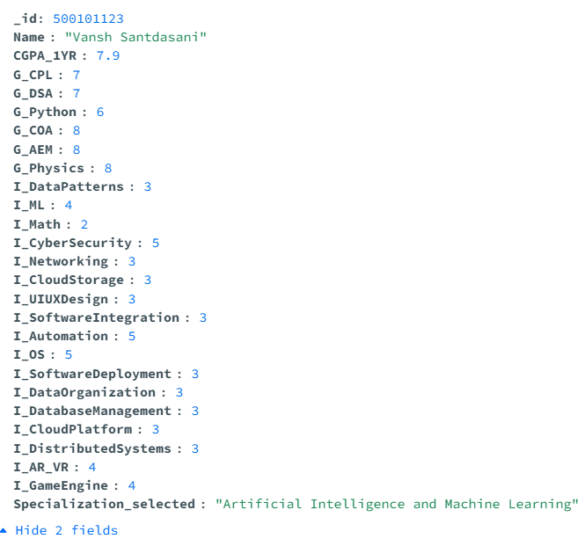
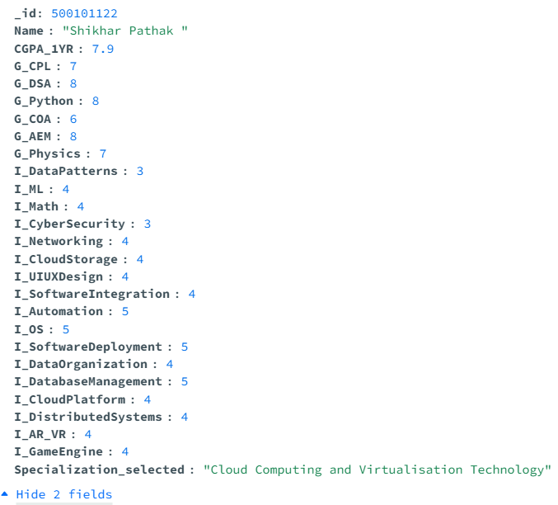
Sample Dataset : Classification
Below is a sample of the dataset used (MongoDB):

Slide 15
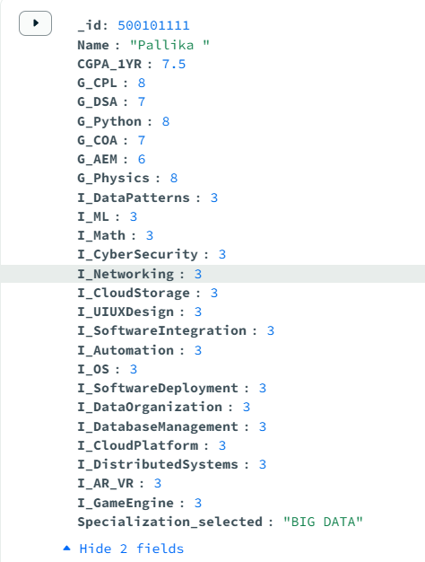
MongoDB for Data Storage
MongoDB as a Database Solution: We have chosen MongoDB for storing the dataset used in training our Decision Tree model due to its flexibility and scalability, making it ideal for handling diverse student data.
Data Structure: The data is structured in MongoDB as follows, where each student record is stored as a document with the SAP ID used as the unique identifier
Key Features: Dynamic Schema Fast Data Retrieval
Benefits of Using MongoDB: Scalability Flexibility Performance

Slide 16
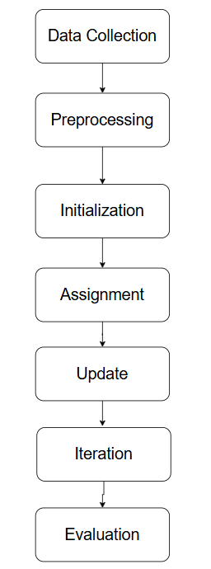
Algorithms
Clustering Algorithm for Performance-Based Grouping: K-Medoids Clustering
Step 1. Data Collection:
Collect data on students' performance metrics, including test scores, attendance, and feedback.
Step 2. Preprocessing:
Normalize the data & handle any missing or outlier values.
Step 3. Initialization:
Randomly select a set of students as the initial medoids.
Step 4. Assignment:
Assign each student to the nearest medoid based on a distance metric.
Step 5. Update:
Recalculate the medoids & Update the cluster assignments based on the new medoids.
Step 6. Iteration:
Repeat the assignment and update steps until medoids no longer change or a convergence criterion is met.
Step 7. Evaluation:
Analyze the clusters to ensure they represent meaningful groupings of students based on performance.
Notes:
Clustering Algorithm for Performance-Based Grouping: K-Medoids Clustering
Step 1. Data Collection:
Collect data on students' performance metrics, including test scores, attendance, and feedback.
Step 2. Preprocessing:
Normalize the data to ensure all features are on the same scale. Handle any missing or outlier values.
Step 3. Initialization:
Randomly select a set of students as the initial medoids (centers of clusters).
Step 4. Assignment:
Assign each student to the nearest medoid based on a distance metric (e.g., Euclidean distance).
Step 5. Update:
Recalculate the medoids as the most centrally located students within each cluster. Update the cluster assignments based on the new medoids.
Step 6. Iteration:
Repeat the assignment and update steps until medoids no longer change or a convergence criterion is met.
Step 7. Evaluation: Analyze the clusters to ensure they represent meaningful groupings of students based on performance. Assess the effectiveness of the clustering by comparing within-cluster distances and ensuring distinct performance levels

Slide 17
Key Components
Performance-Based Student Grouping using K-Medoids Clustering
Point class: Represents a student with all attributes like SAP ID, CGPA, grades in various subjects, interest levels in different areas
KMedoid class: Implements the clustering algorithm
Methods: pickMediode(), euclideanDist(), assignPoint(), costCalculate(), clustering()

Slide 18
Working Of Algorithms
Performance-Based Student Grouping using K-Medoids Clustering
Load Data - The program reads the student data from a specified CSV file containing the attributes of each student.
Randomly select initial medoids - The Algorithm selects k random points as initial medoid. k will be taken input from the user
Cluster Assignment - Each point is assigned to the nearest medoid based on Euclidean distance. - This step is repeated for multiple iterations to find the clustering with the minimum cost
Compute total cost of clustering - For each iteration, the total cost of clustering is calculated, and the clustering with the lowest cost is selected as the best solution
Perform clustering 5 times - Clustering process is repeated 5 times & for each iteration the clusters are being displayed in the output - Clustering with minimum cost is being selected
Display final best clusters - Clustering with minimum cost is displayed as the final best cluster.

Slide 19
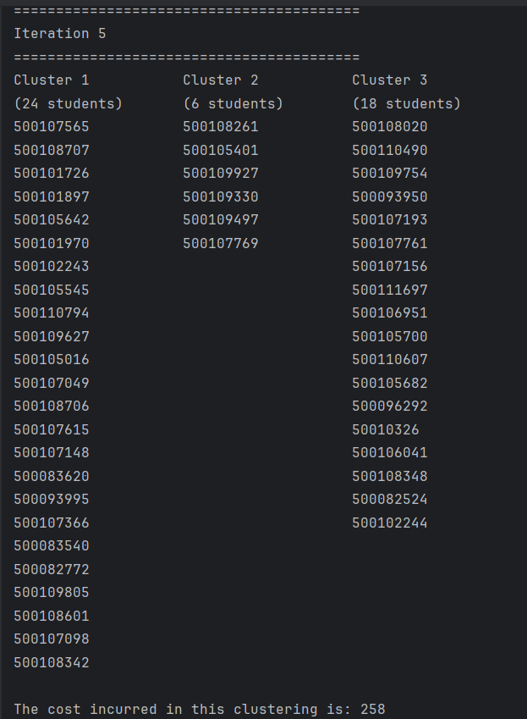
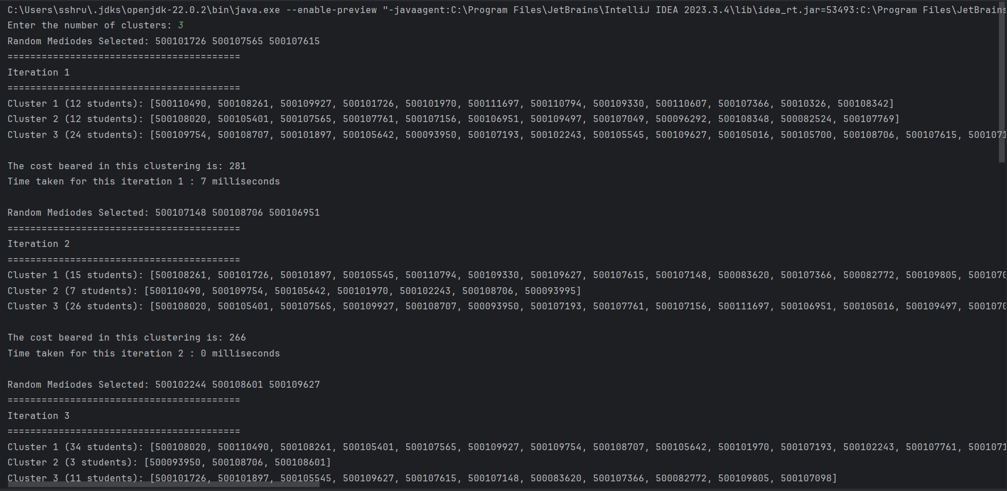
Outputs

Slide 20
Data Collection For Clustering
Data Collection Process: We collected initial data using a Google form with around 50 entries.
Storage & Preprocessing: Collected data is stored in csv file and removed the specialization field because there’s no need of specialization in clustering. As mentioned earlier, Clustering is based on the performance.
Sample Dataset Structure: The dataset includes comprehensive academic and technical skill-related information.
Features Included: Academic Scores: CGPA of the 1st year, grades in core subjects like DSA, Python, COA, etc. Technical Interests: Self-assessed interest levels in fields like Data Patterns, Machine Learning, Cybersecurity, Networking, Cloud Storage, and others.

Slide 21
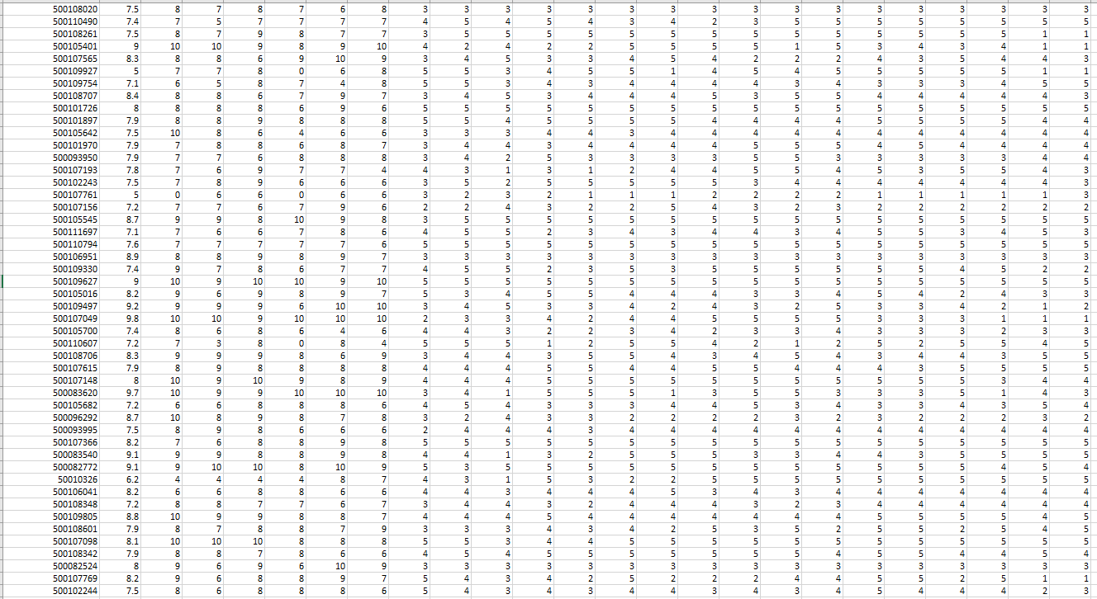
Sample Dataset : Clustering
Below is a sample of the dataset used (CSV):

Slide 22
CSV for Data Storage
CSV as a Database Solution: CSV is used as data storage in clustering because it provides a simple, structured format for storing and sharing tabular data. Each row represents a data point, and columns represent features, making it easy to import, manipulate, and analyze data. CSV files are widely supported and human-readable, making them convenient for preprocessing and feeding into clustering algorithms. And also we want to add a feature that will need CSV (discussed about it in future enhancements)
Data Structure: The data is structured in CSV as follows, where each student record is stored as a comma separated values with the SAP ID used as the unique identifier
Key Features: Simplicity Wide Compatibility
Benefits of Using CSV: Ease Of Use Light Weight Storage Portability
Notes:
Simplicity: CSV files are easy to read and write, using plain text format with values separated by commas, making them accessible for both humans and programs.
Wide Compatibility: CSV is widely supported across different platforms and applications, including spreadsheet software (like Excel) and programming languages, making data sharing and integration convenient.

Slide 23
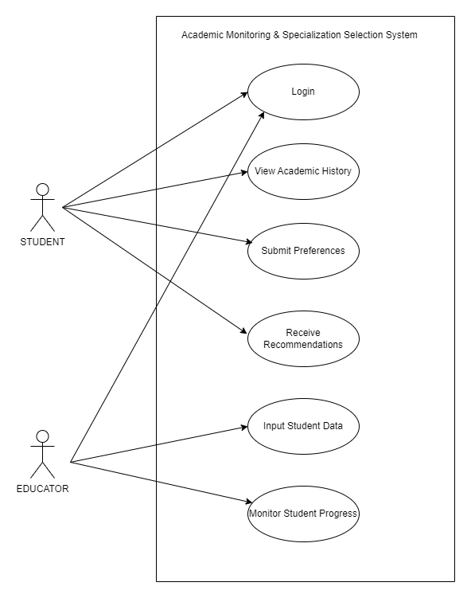
Design diagrams
Use case diagram:

Slide 24
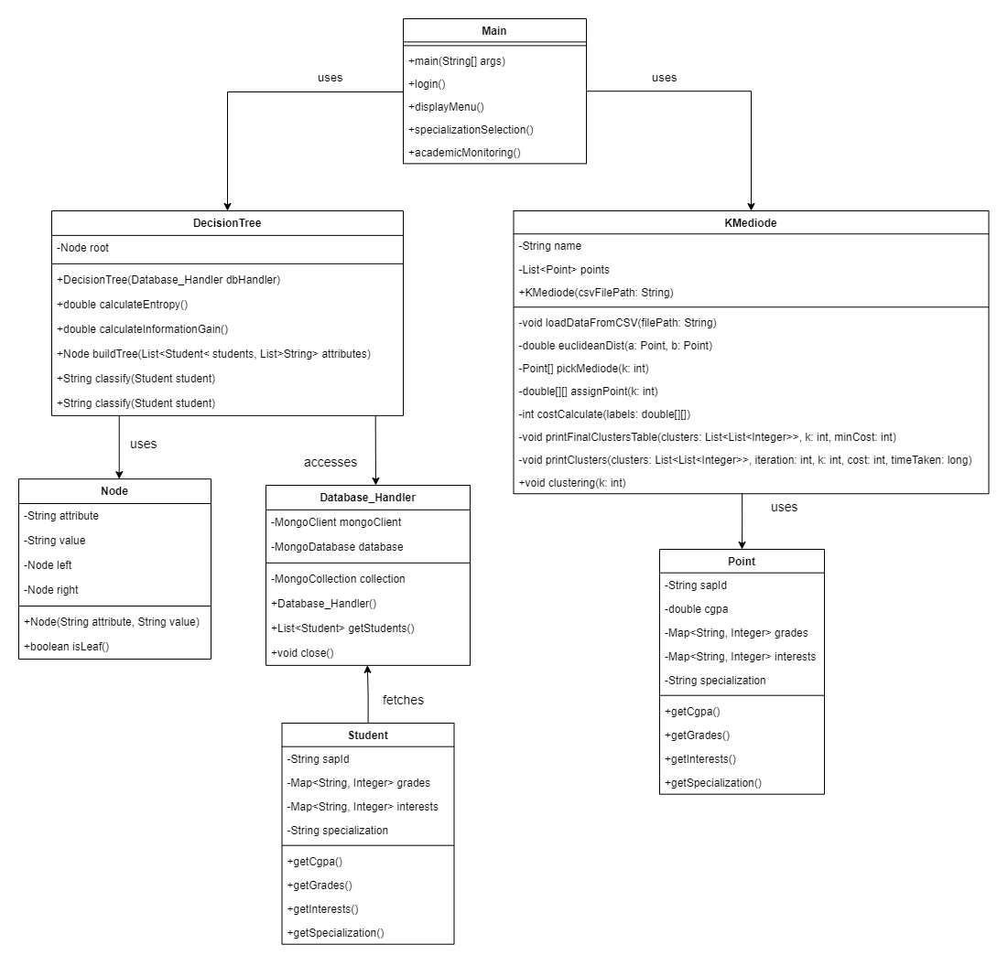
Class diagram

Slide 25
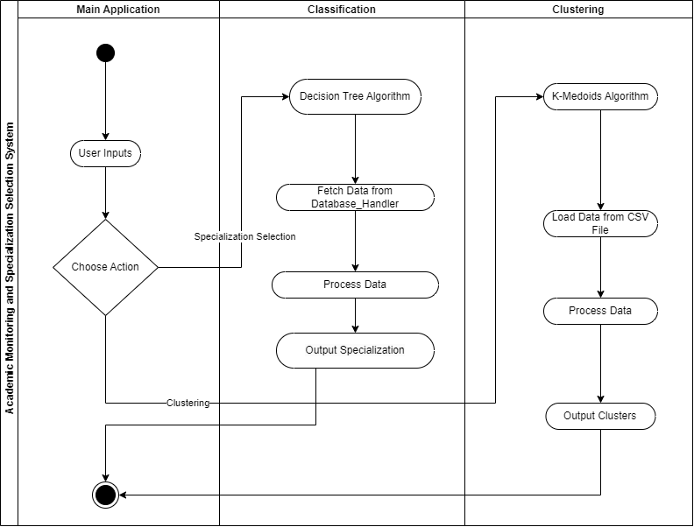
Activity diagram

Slide 26
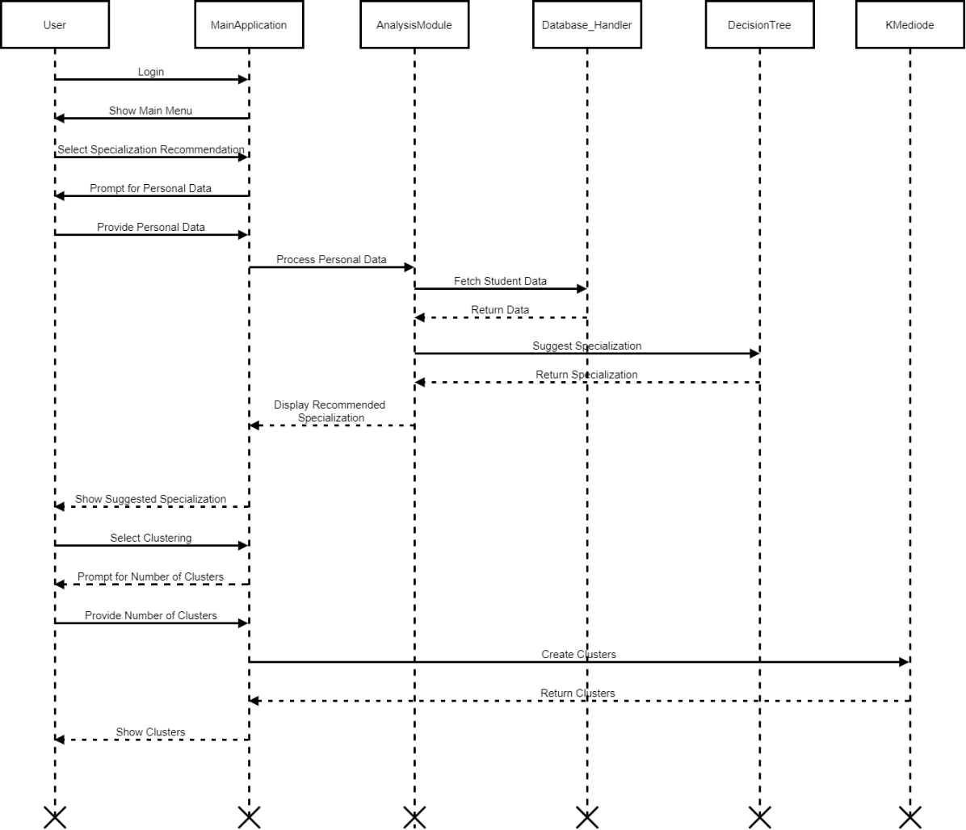
Sequence diagram

Slide 27
SWOT Analysis
Strengths:
Data-driven decision-making
Personalized learning recommendations
Opportunities:
Growing demand for personalized education
Potential partnerships with institutions and EdTech companies
Weaknesses:
Dependence on accurate data input
Complex implementation across diverse systems
Threats:
Privacy concerns regarding student data
Changing educational policies and standards
Notes:
Strengths:
Data-driven decision-making for both students and educators
Personalized recommendations for academic specializations
Automated grouping of students based on performance
Potential to improve overall educational outcomes and student satisfaction
Weaknesses:
Dependence on accurate and comprehensive data input
Potential complexity in implementation across diverse educational systems
Requires ongoing maintenance and updates to remain effective
May face resistance from traditional educational methodologies
Opportunities:
Growing demand for personalized learning experiences
Increasing focus on data-driven education management
Potential for partnerships with educational institutions and EdTech companies
Expansion into related areas such as career counseling and curriculum development
Threats:
Privacy concerns regarding student data collection and use
Rapid changes in educational policies and standards

Slide 28
Area of Application
It addresses two primary areas:
Specialization Guidance: The system helps students choose appropriate academic specializations based on their academic history and personal preferences. This personalized guidance aims to align students' career goals with their academic strengths, improving their chances of success in their chosen fields.
Performance-Based Grouping: The system assists educators and administrators in grouping students according to their academic performance. By using clustering algorithms, the system enables educators to identify different performance levels and provide targeted support to students, helping them improve in weaker areas and offering advanced opportunities to high performers.

Slide 29
Future Enhancements
Real Time Clustering Updates
Educators can input their dataset in form of CSV file
Integrating both the algorithms together
Add a functionality of viewing student’s history
Take feedbacks from student
Integration with Graphical interface
Compatible with different datasets

Slide 30
Conclusion
Our project introduces a system that helps students gain better insight into their specializations and recommends which specialization to choose based on their performance and preferences.
It also assists educators by grouping students based on their academic performance, allowing for more focused and efficient teaching.
This approach enables a more personalized learning experience for each student, helping them learn faster and more effectively.
The project contributes to creating a more responsive, efficient, and student-centered educational environment, leading to improved learning outcomes and better student management.

Slide 31
References
[1] Singh, Samrat, and Vikesh Kumar. "Performance analysis of engineering students for recruitment using classification data mining techniques." International Journal of Science, Engineering and Computer Technology 3, no. 2 (2013): 31.
[2] Le Quy, Tai, Gunnar Friege, and Eirini Ntoutsi. "A review of clustering models in educational data science toward fairness-aware learning." Educational data science: Essentials, approaches, and tendencies: Proactive education based on empirical big data evidence (2023): 43-94.
[3] Bobâlcă, Claudia, Oana Ţugulea, and Cosmina Bradu. "How are the students selecting their bachelor specialization? A qualitative approach." Procedia economics and Finance 15 (2014): 894-902.
[4] Kurniawan, Tri Basuki, and Indah Hidayanti. "Classification Algorithms to Determine Students’ Specialization in a Higher Education Institution." Journal of Data Science 2023 (2023).

Slide 32
Thank You

